Slide 2

2
1
Lesson 21
Polynomial I

Slide 3
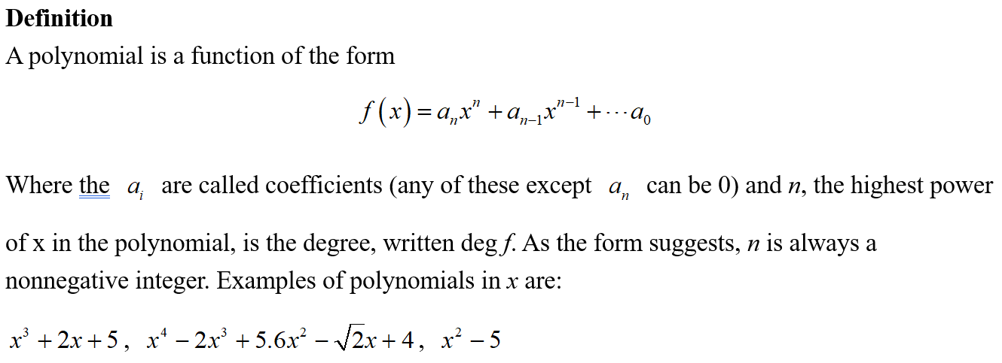
Lead in

Slide 4
Chapter 1
Multiplying and Dividing Polynomials

Slide 5
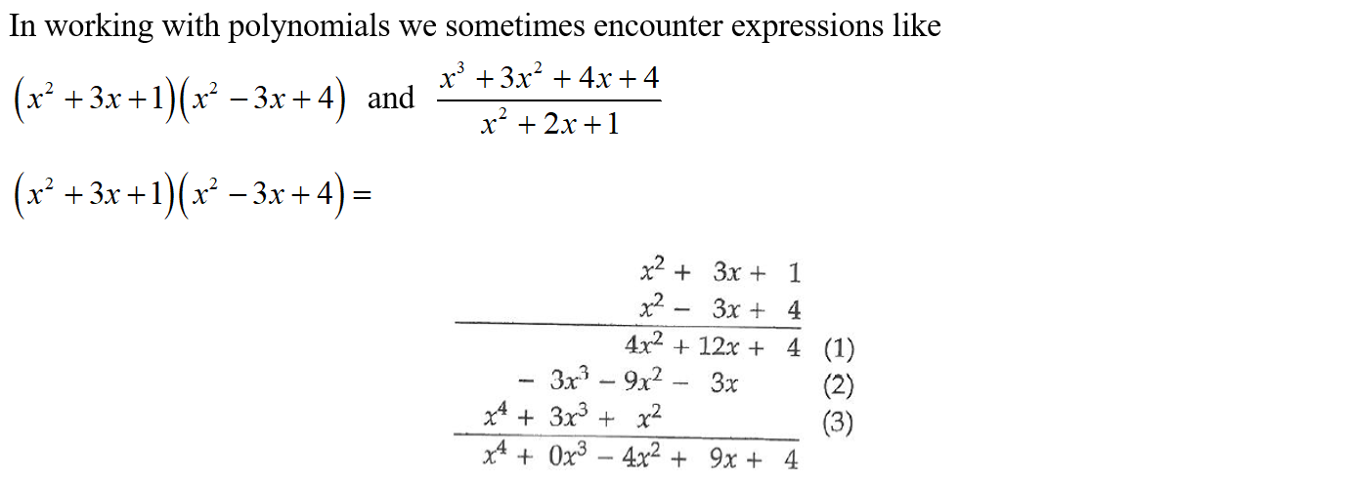
Lead in

Slide 6
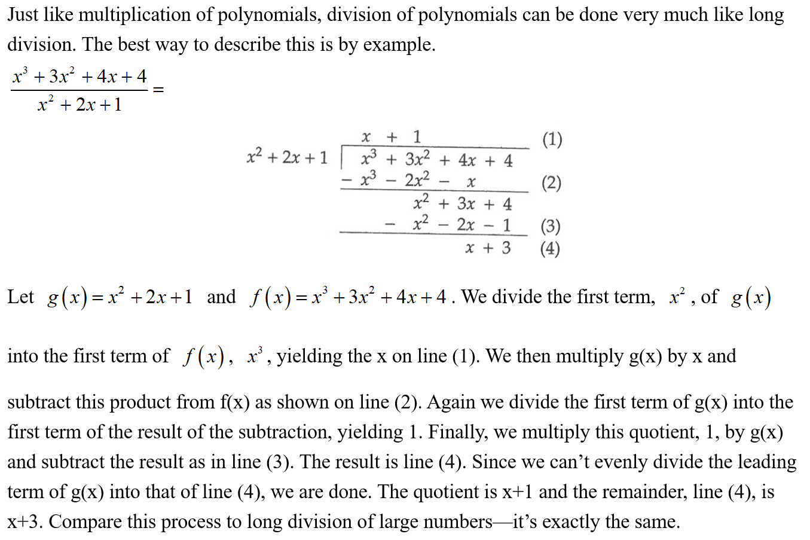
Lead in

Slide 7
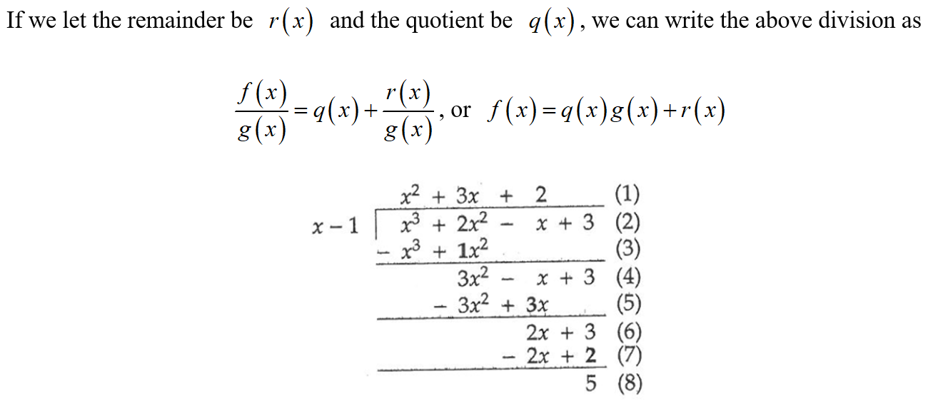
Lead in

Slide 8
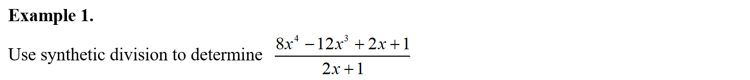
Example

Slide 9
Example

Slide 10
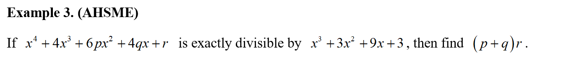
Example

Slide 11
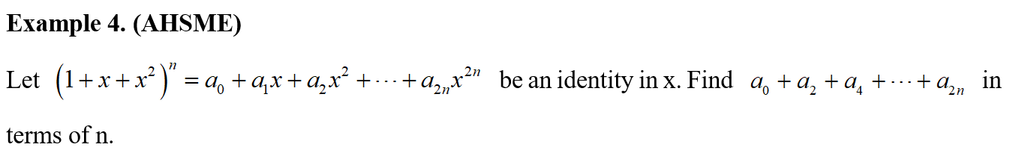
Example

Slide 12
Chapter 2
Finding Roots of Polynomials

Slide 13
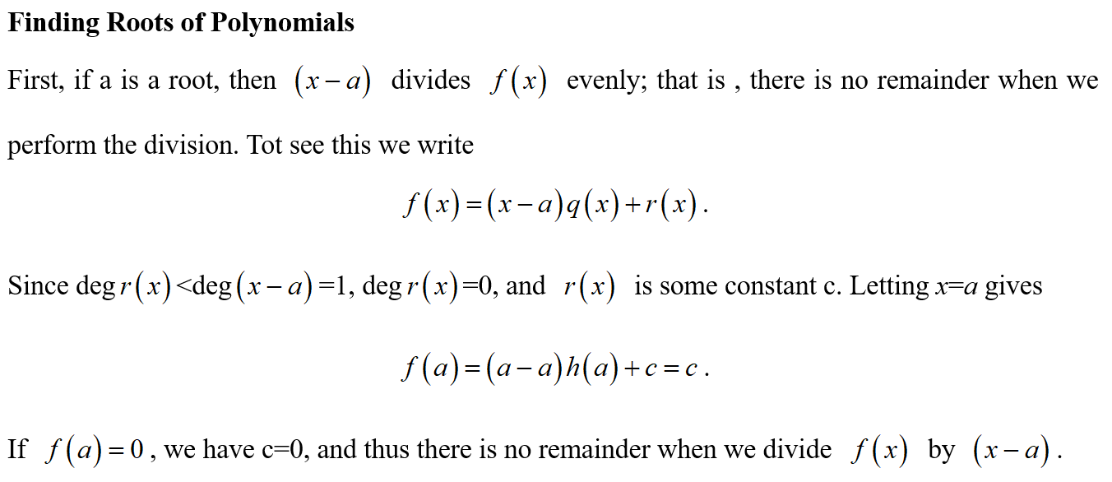
Lead in

Slide 14
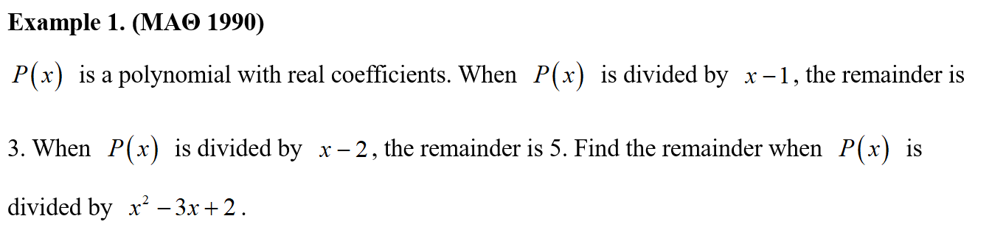
Example

Slide 15
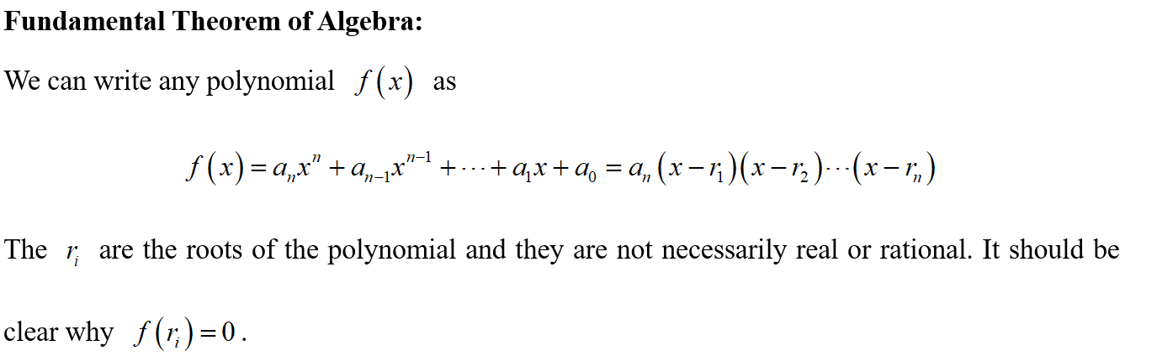
Lead in

Slide 16
Example

Slide 17
Example

Slide 18
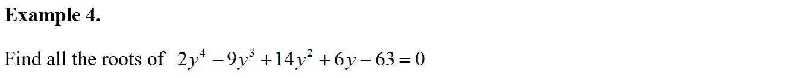
Example

Slide 19
Example

Slide 20
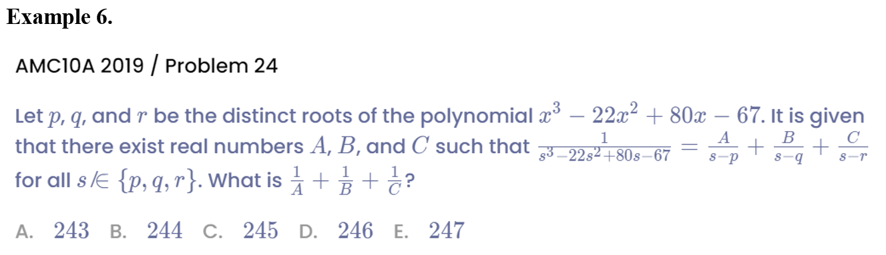
Example

Slide 21
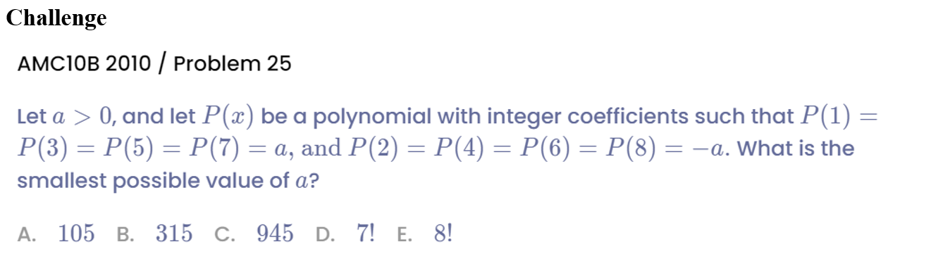
Challenge

Slide 22
See You Next Time!

